Slide 1
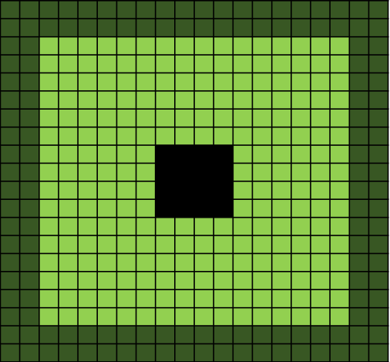

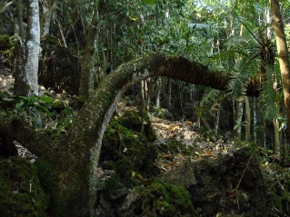
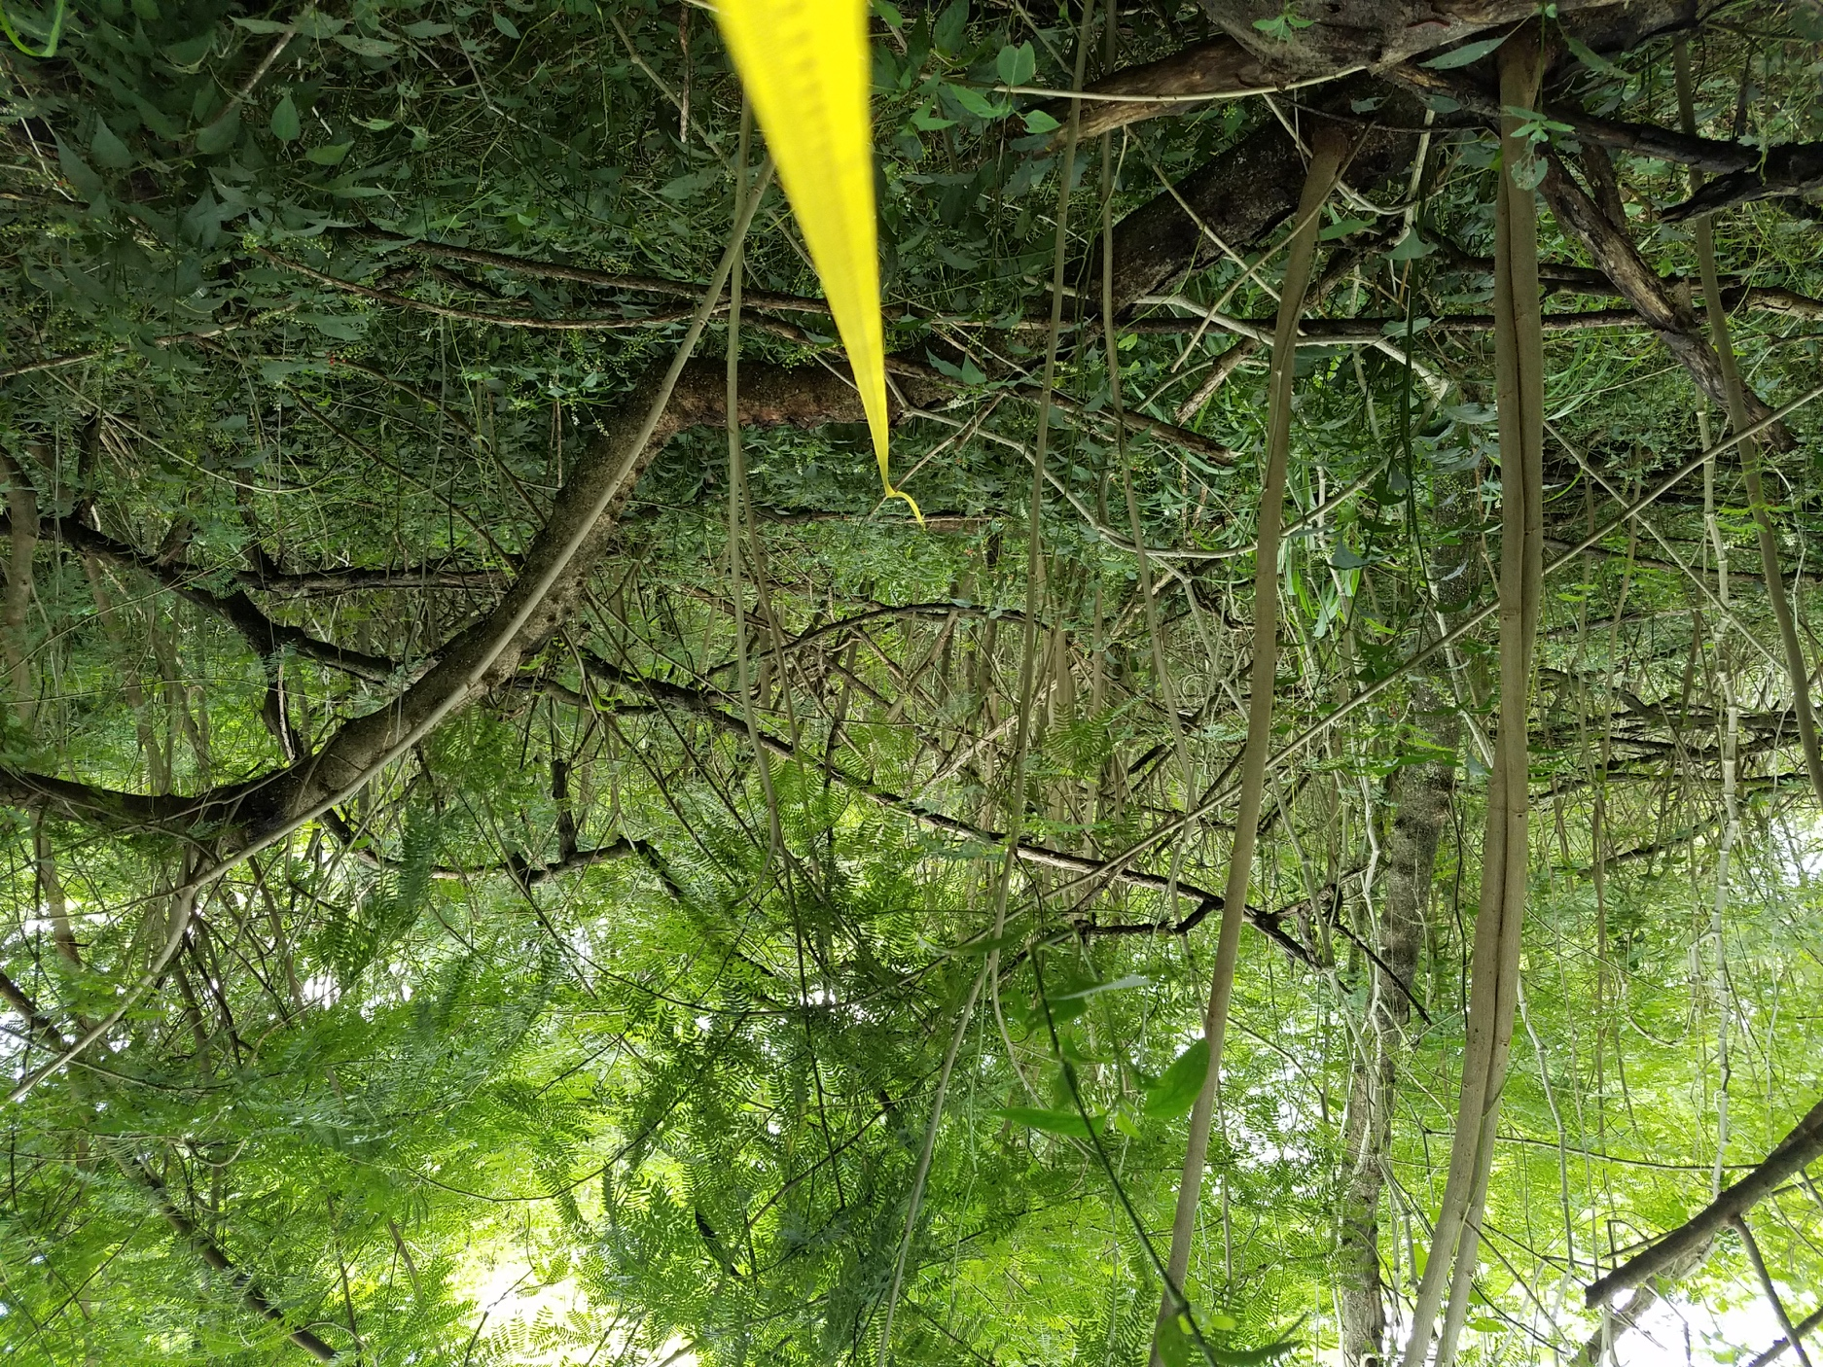

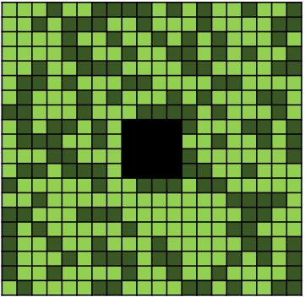
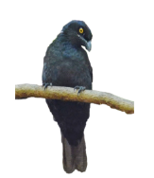
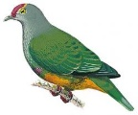
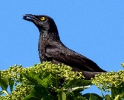


Restoring Seed Dispersal of Native Seeds
Varying landscape configurations
Native Forest
Degraded Forest
Service Providers
Scenario Specific Recommendations
+ | Generalist | +
+ | Home Range Size | -
+ | Ecotone Crossing | -
+ | Flight Distance | -

Slide 2
Border
Even
Intact Habitat
Corridor
Random
Degraded Habitat
Refuge

